Slide 1
Software Project Management
Risk management
Dr. D Evangelin geetha
Associate professor
Department of master of computer applications
Ramaiak institute of technology
Bangalore - 560054

Slide 2
Learning objectives
Identify the factors putting a project at risk
Categorize and prioritize actions for risk elimination or containment
Quantify the likely effects of risk on project timescales

Slide 3
risk
Definition
  “an uncertain event or condition that, if it occurs, has a positive or negative effect on a project’s objectives”
  “the chance of exposure to the adverse consequences of future events”
Key elements
  It relates to the future
  It involves cause and effect

Slide 4
Categories of risk
Project risk
Business risk

Slide 5
Categories of risk
Sociotechnical model model of risk
Actors
  People - High staff turn over
Technology
  Appropriateness of technology
Structure
  Needs user participation
Tasks
  The complexity of work leads to delays
Actors
Structure
Technology
Tasks

Slide 6
Risk management approaches
Reactive approaches
  Take no action until an unfavourable event occurs
  E.g. server hosting the project data
Proactive approaches
  Try to anticipate the possible risks that the project is susceptible to
  E.g. some personnel may leave the project

Slide 7
Framework for dealing with risk
Planning for risk includes these steps
  Risk identification
  Risk analysis and prioritization
  Risk planning
  Risk monitoring
  1 to 3 can be probably repeated
  E.g. staff inexperience with new technology

Slide 8
Risk identification
Two main approaches
  Checklist
  Brainstorming

Slide 9
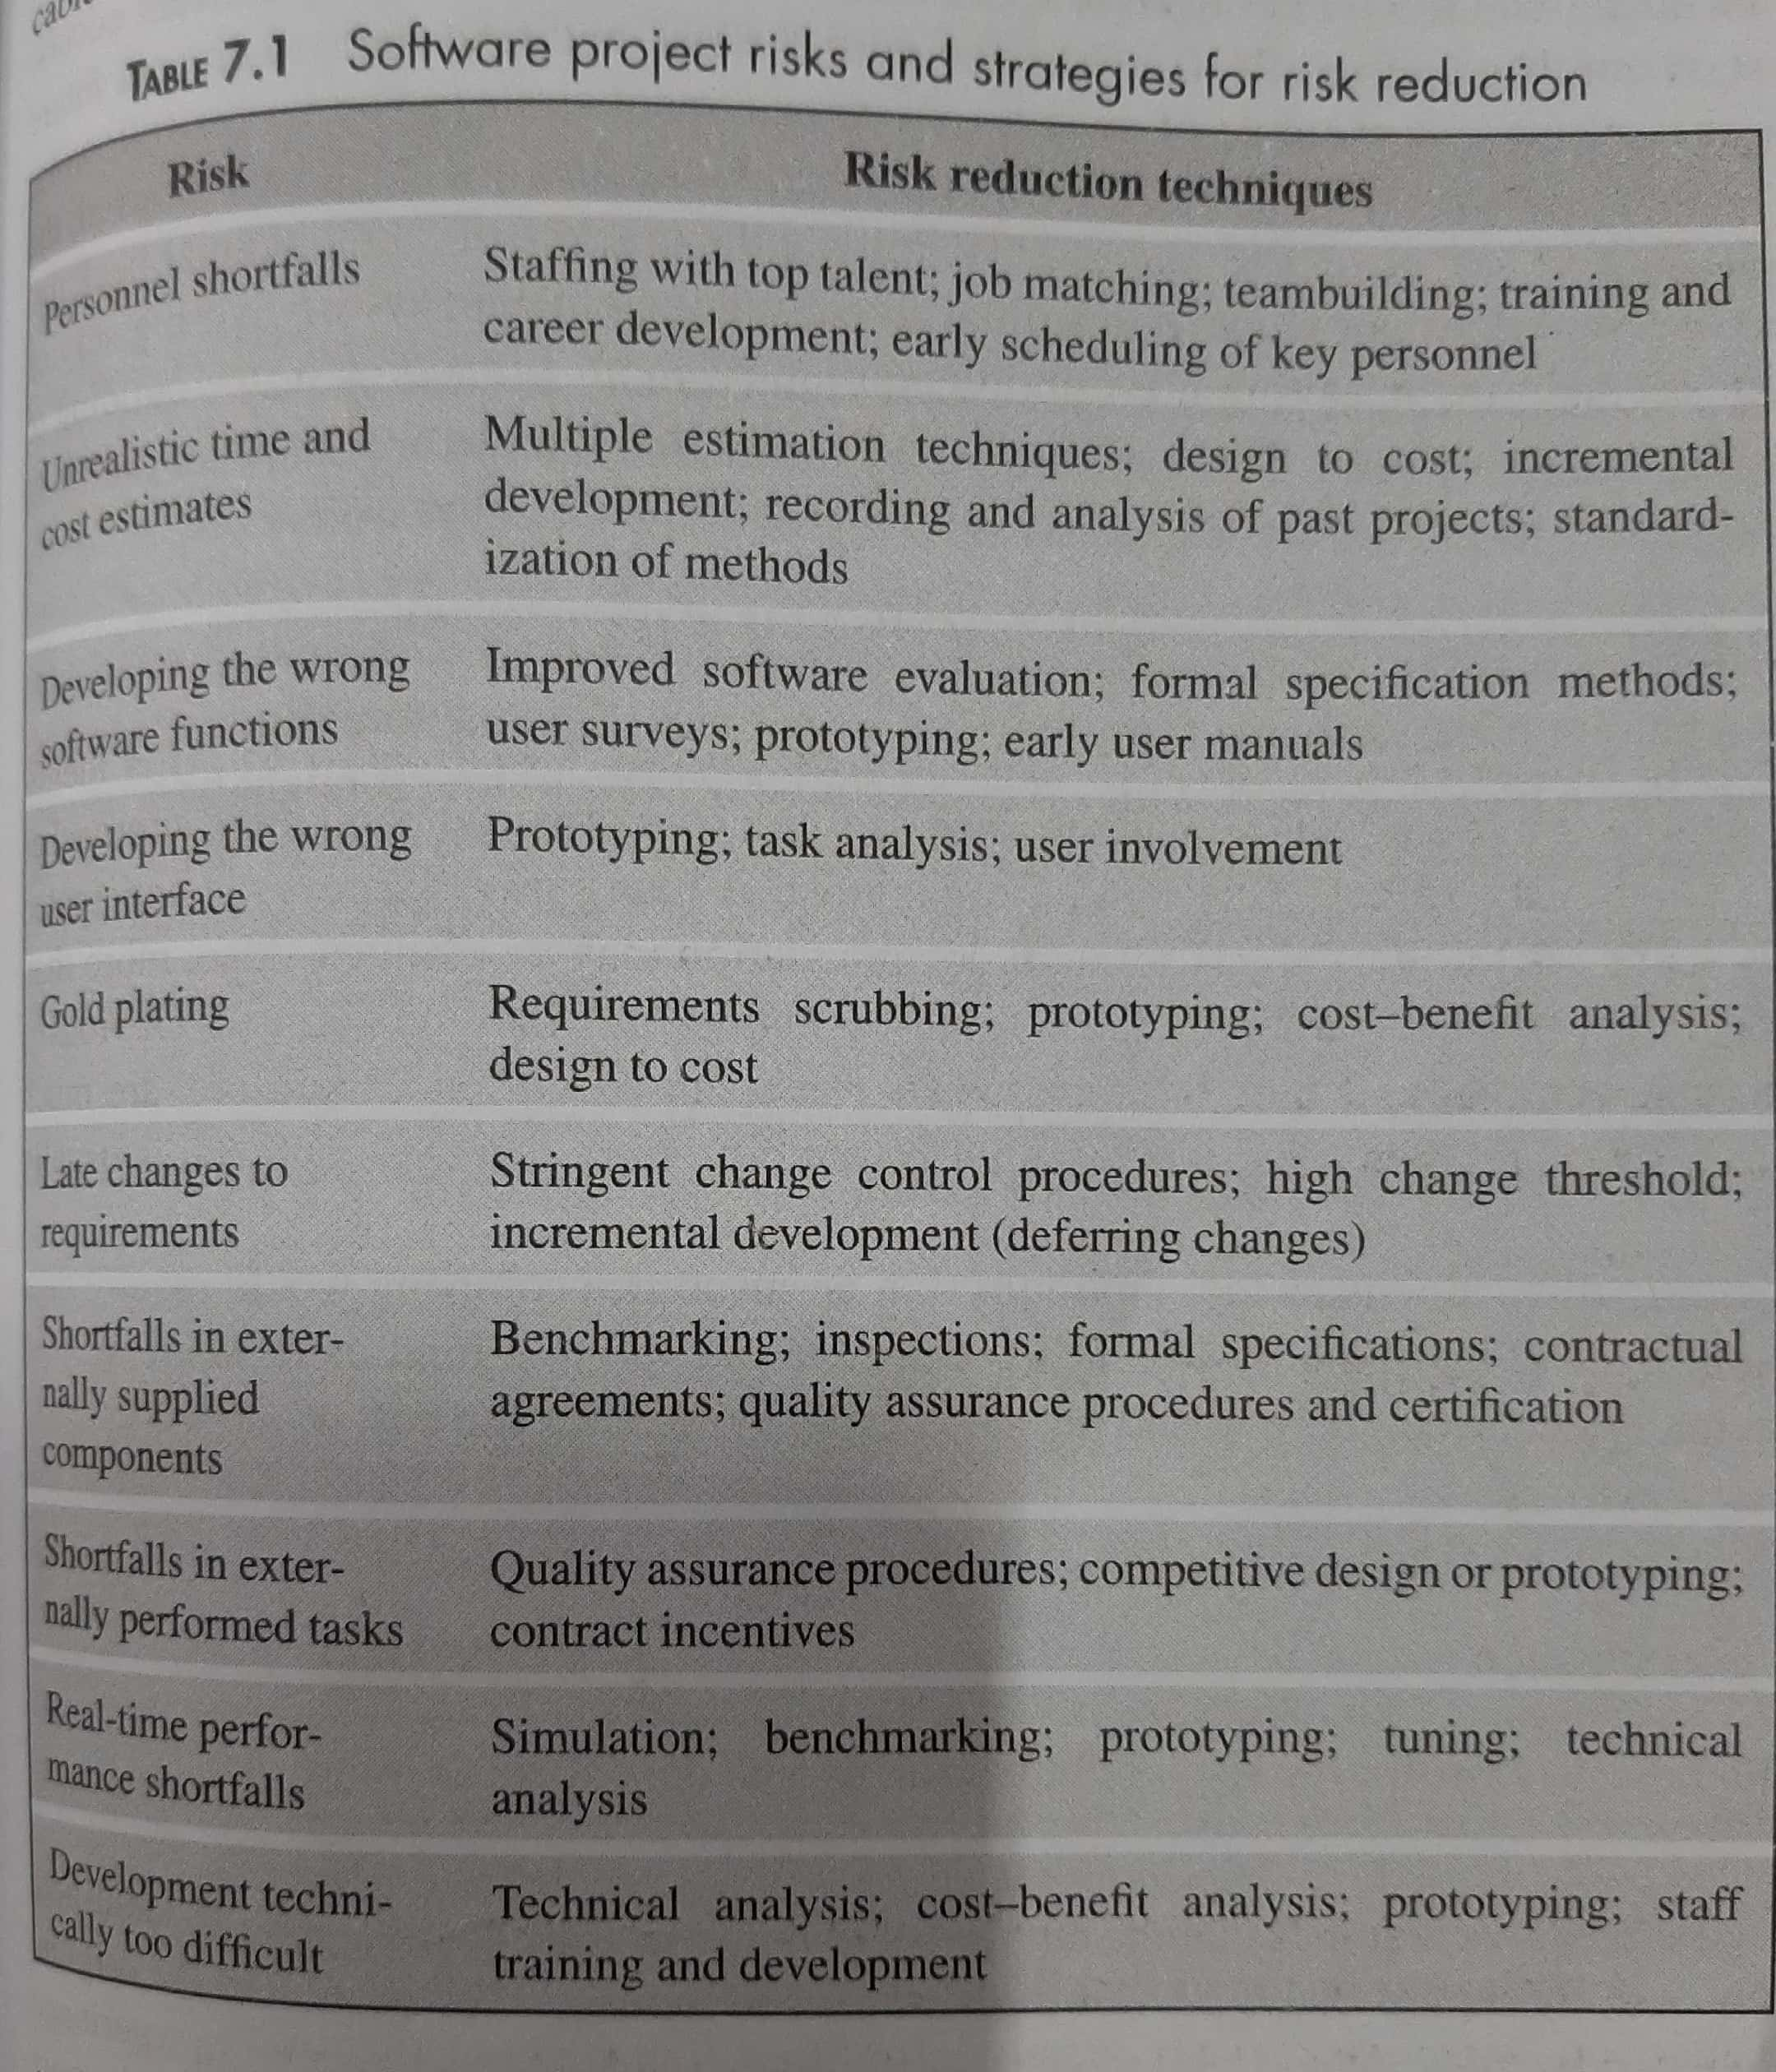
Risk identification
  Checklist
  Gold plating: Eg. after having met the requirements, the project manager or the developer works on further enhancing the product, thinking the customer will be delighted to see additional or more polished features, rather than what was asked for or expected
  Requirements Scrubbing is a practice in which a product specification is carefully examined for unnecessary or overly complex requirements

Slide 10
Risk identification
Brainstorming
  Representatives of the main stakeholders

Slide 11
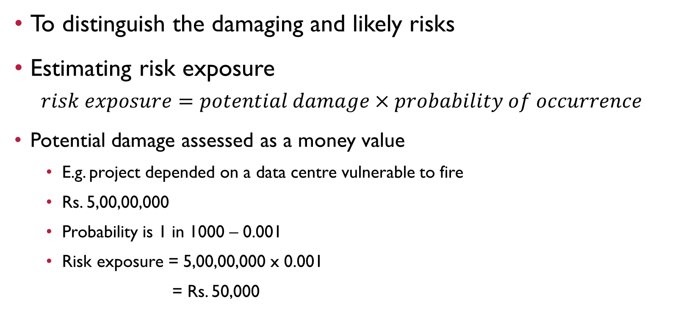
Risk assessment
To distinguish the damaging and likely risks
Estimating risk exposure
$$risk exposure=potential damage×probability of occurrence$$
Potential damage assessed as a money value
  E.g. project depended on a data centre vulnerable to fire
  Rs. 5,00,00,000
  Probability is 1 in 1000 – 0.001
  Risk exposure = 5,00,00,000 x 0.001
  = Rs. 50,000

Slide 12
Risk assessment
Sometimes gain also
  Testing of a software component done in 3 days instead of 6 days
  Probability of completion of a task in 4 days – 5%
  Probability of completion of a task in 5 days – 10%
  Accumulated probability for 7 days – 65%

Slide 13
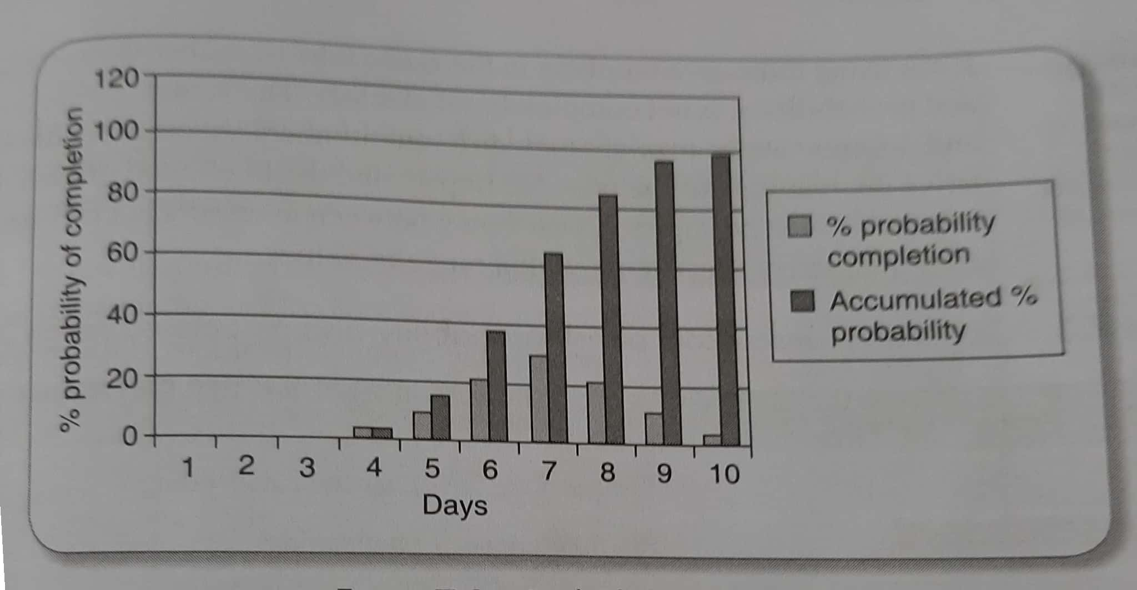
Risk assessment

Slide 15
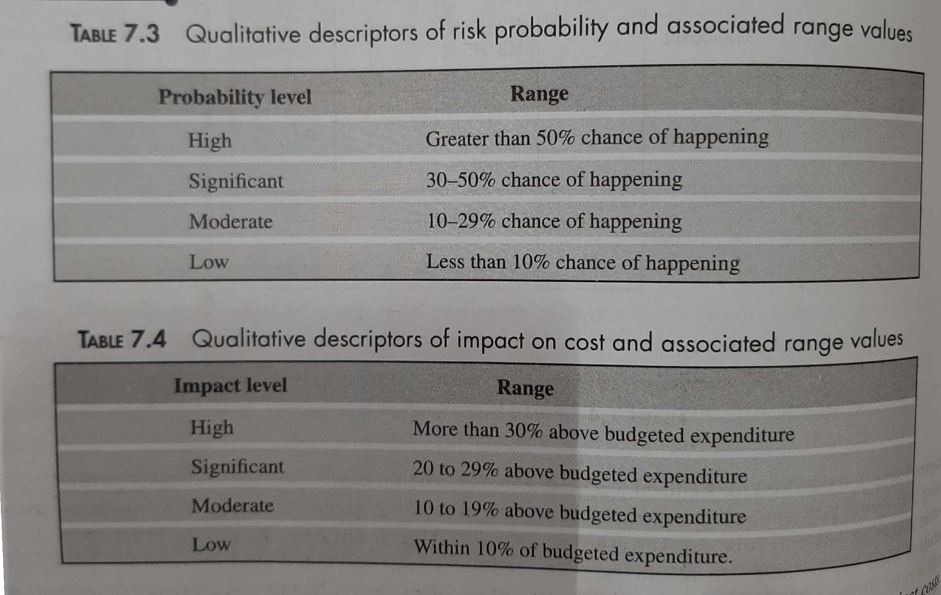

Slide 16
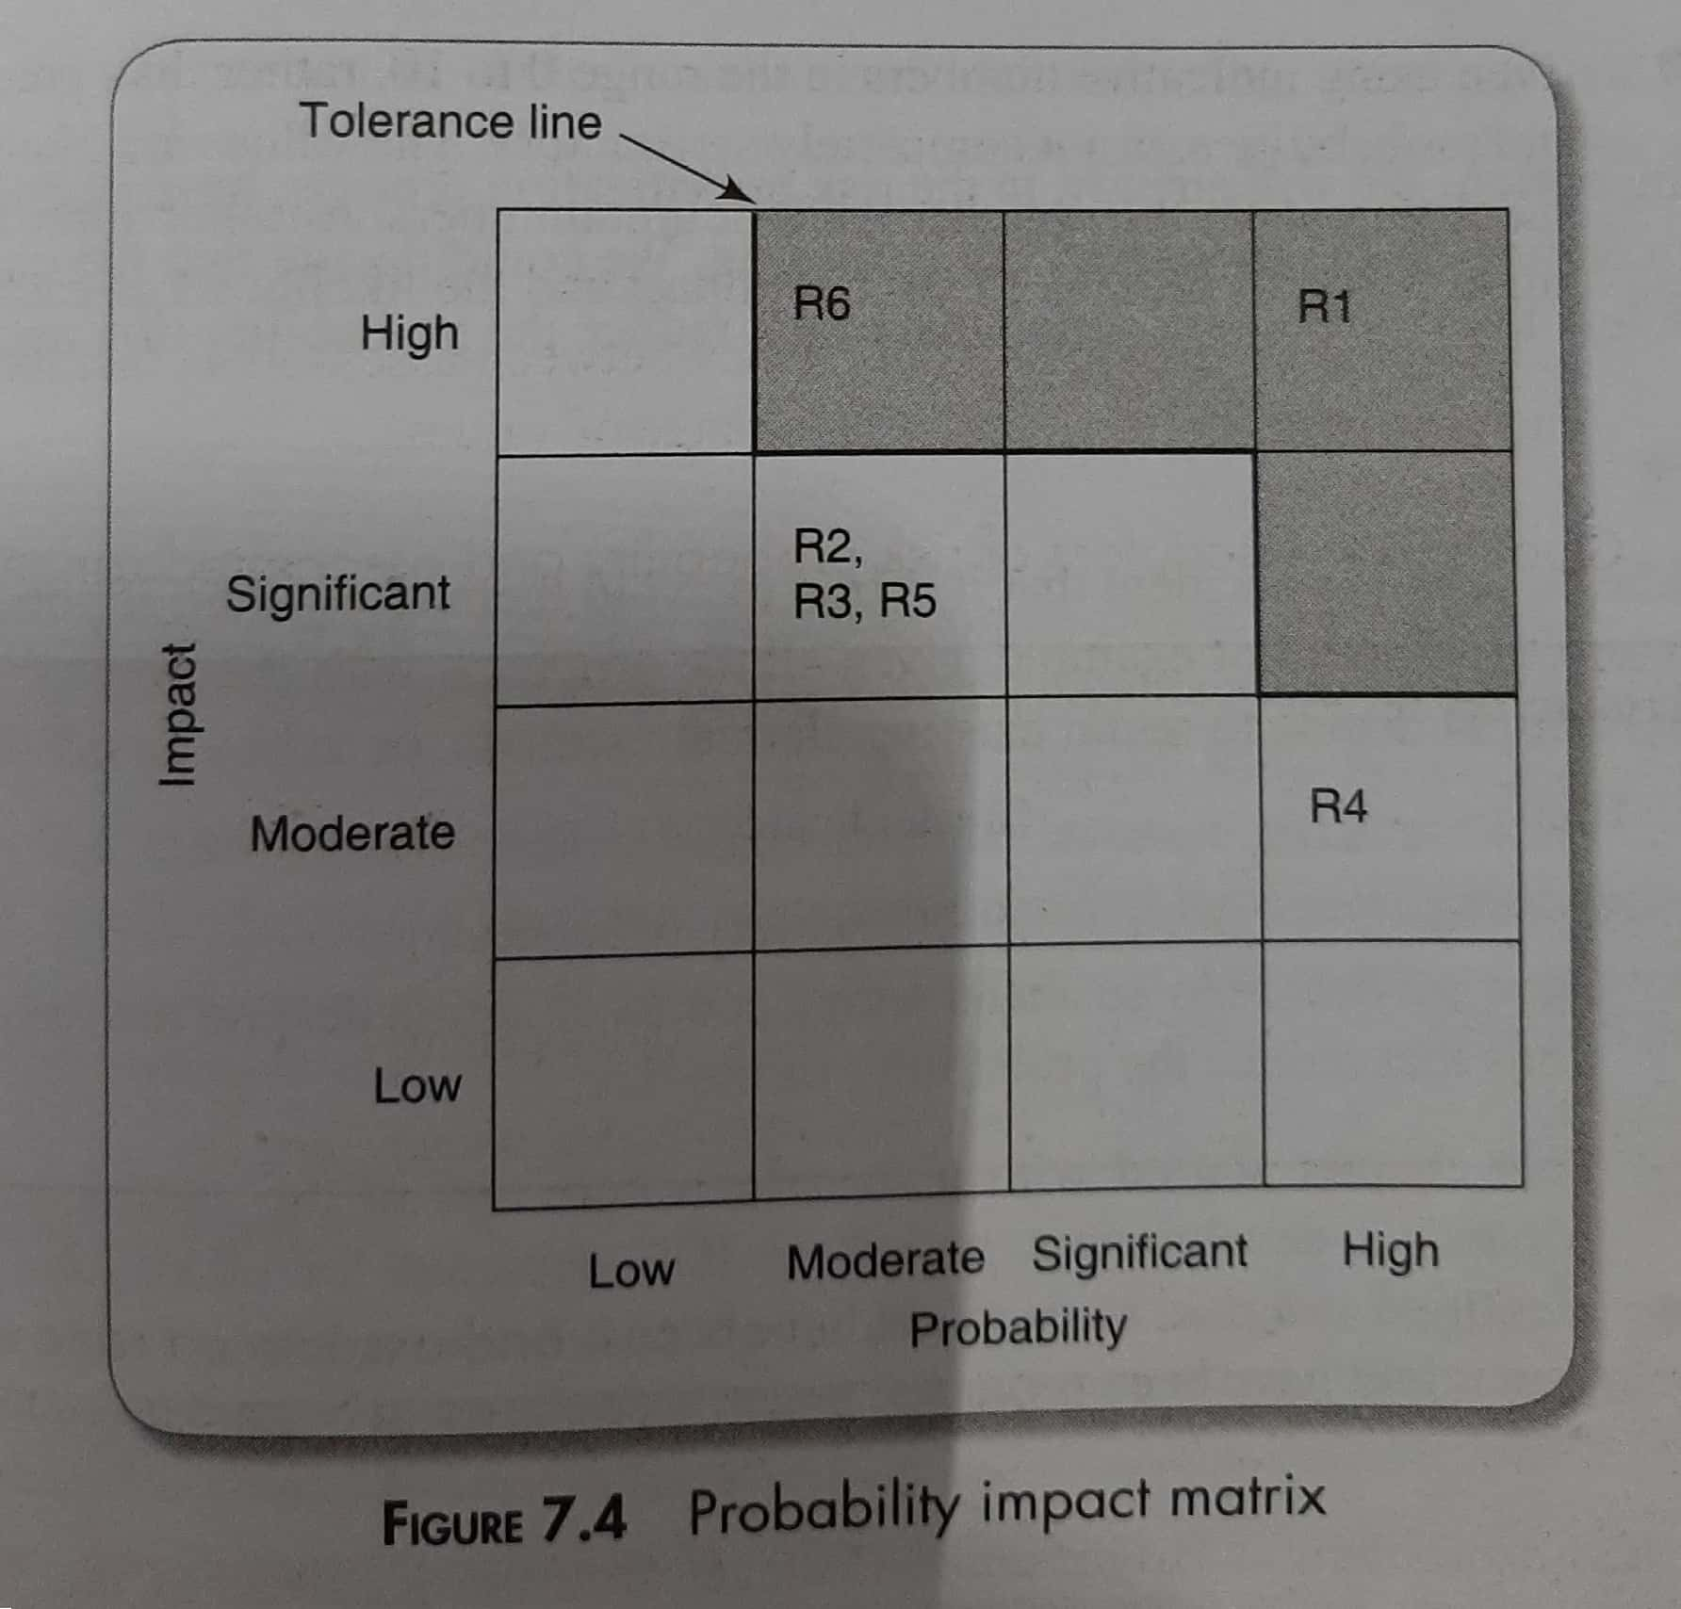

Slide 17
Risk planning
Risk acceptance
Risk avoidance
Risk reduction and mitigation
Risk transfer

Slide 18
Risk planning
Risk acceptance
  Damage of risk would be less than costs of action to reduce risk
Risk avoidance
  Problems identified with developing software solutions
    Retain existing clerical methods
    Buy an off-the-shelf solution

Slide 19
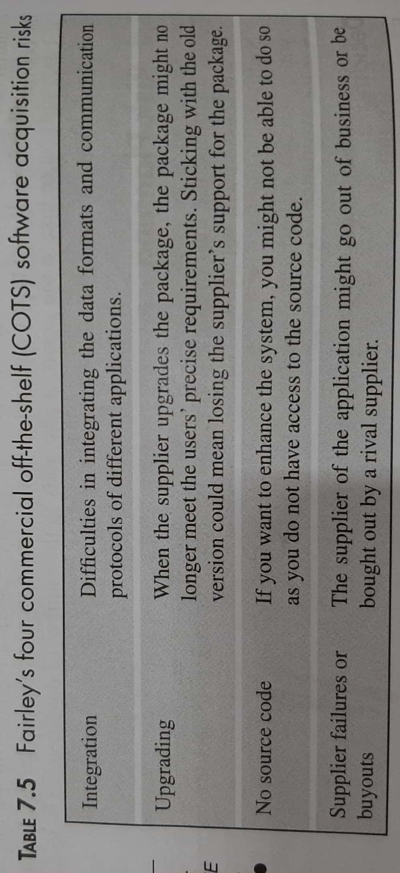
Risk planning
Risk reduction and mitigation
  Take precautions
  E.g. 1 - two of the staff departed for other jobs
  Precaution: Announcing bonus on completion
  E.g. 2 – payroll database to be accessed by another application

Slide 20
Risk planning
Risk reduction and mitigation
Risk reduction – to reduce the likelihood of occurrence
Risk mitigation – action taken to ensure that the impact of the risk is lessened
  E.g. – data corruption – back-ups

Slide 21
Risk planning
Risk transfer
  Software development task is outsourced to an outside agency for a fixed fee

Slide 22
Risk Management
Contingency
Deciding on the risk actions
  Value of damage x prob. Of occurrence
  Risk reduction leverage = (RE_{before} – RE_{after})/(cost of risk reduction)
  E.g. to replace a hardware configuration – Rs. 2,00,00,000
  Prob. of occurrence – 1%
Creating and maintaining the risk register

Slide 23
Boehm’s top 10 risks and counter measures
Personnel shortfall
Unrealistic schedules and budgets
Developing the wrong functions
Developing the wrong user interface
Gold-plating
Continuing stream of requirements changes
Shortfalls in externally-furnished components
Shortfalls in externally performed tasks
Real-time performance shortfalls
Straining computer science capabilities

Slide 24
Risk mitigation, monitoring, and management (rmmm) plan
Risk table
Each row
  Name of the risk
  Probability
  Impact
  Specific conditions or events that to be monitored
  Possible ways to avoid the risk
  Contingency plan

Slide 25
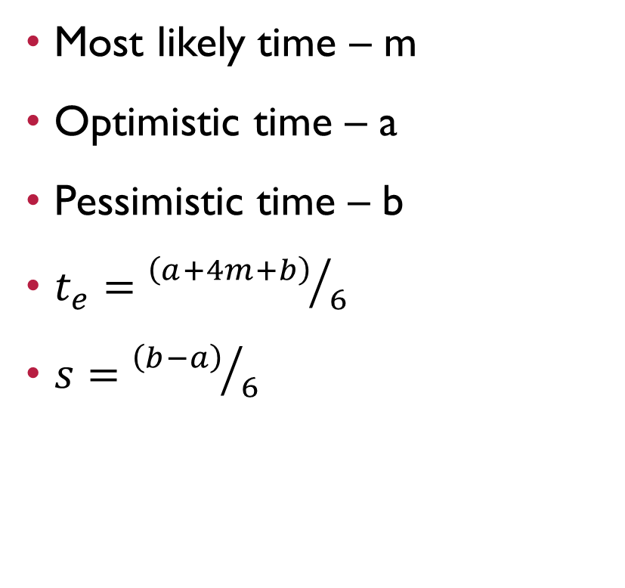
PERT (Program Evaluation and Review Technique)
Most likely time – m
Optimistic time – a
Pessimistic time – b
$t_{e}={\left(a+4m+b\right)}/6$
$s={\left(b−a\right)}/6$

Slide 26
Activity | Optimistic (a) | Most likely (m) | Pessimistic (b) | Expected (t_{e})
A | 5 | 6 | 8
B | 3 | 4 | 5
C | 2 | 3 | 3
D | 3.5 | 4 | 5
E | 1 | 3 | 4
F | 8 | 10 | 15
G | 2 | 3 | 4
H | 2 | 2 | 2.5

Slide 27
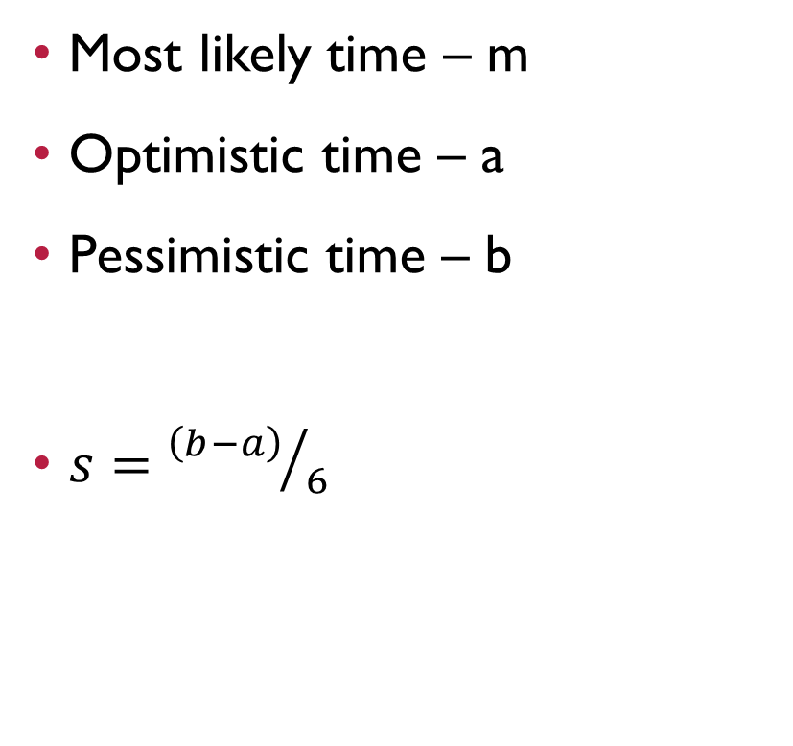
Activity standard deviation
Most likely time – m
Optimistic time – a
Pessimistic time – b
$s={\left(b−a\right)}/6$

Slide 28
Likelihood of meeting targets
Three-step method for calculating the probability of meeting or missing a target date
  Calculate the standard deviation of each project event
  Calculate the z value for each event that has a target date
  Convert z values to a probabilities

Slide 29
Calculating the standard deviation of each project event
Add SD of the activities in the path
  Add their squares and find the square root of the sum

Slide 30
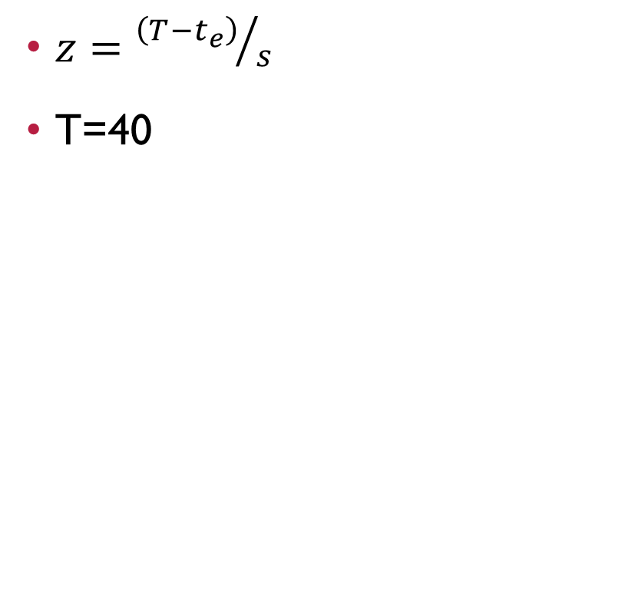
Calculating z value
(40-36.1)/2.2
3.9/2.2
z=1.77
T=39
Z=(39-36.1)/2.2
=2.9/2.2
=1.32
91%
9%
96%
4%
$z={\left(T−t_{e}\right)}/s$
T=40

Slide 31
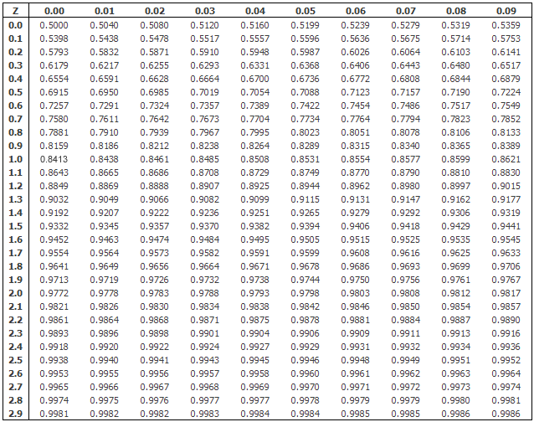

Slide 32
Advantages of PERT
Focuses attention on the uncertainty of forecasting
To calculate standard deviation, to rank the activity

